Slide 1


Slide 2
E-COMMERCE
Team: Decoding
Presented by: Muzammal Hussain & Kashif

Slide 3
E-COMMERCE
What is E-commerce?
Types of E-commerce
Benefits of E-commerce
Disadvantages of E-commerce
Popular E-commerce Platforms
Key Elements of a Successful E-commerce Business
Digital Marketing and E-commerce
E-commerce and Mobile Apps
Growth of E-commerce in Pakistan
Future Opportunities in E-commerce
Payment Methods in E-commerce
How to Start an E-commerce Business?
Secrets to Success in E-commerce
Conclusion

Slide 4
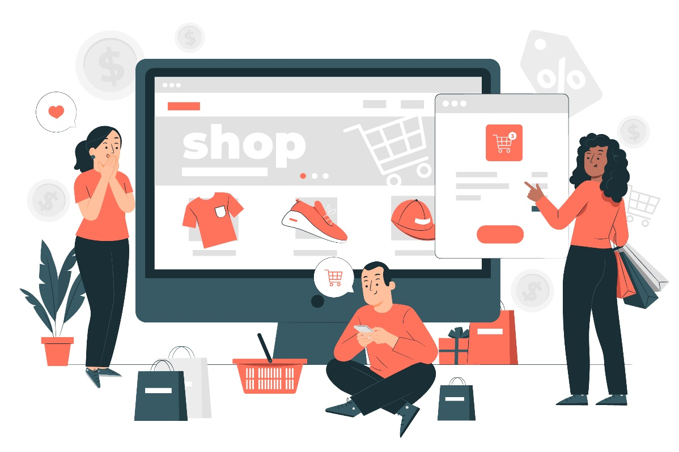
What is E-commerce
Buying and selling through the internet
The growing trend of online business
An alternative to physical stores
24/7 availability and easy access
Direct connection between buyers and sellers

Slide 5
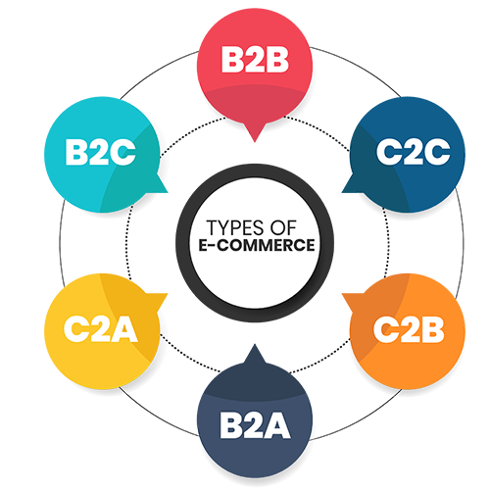
Types of E-commerce
B2B (Business to Business)
B2C (Business to Consumer)
C2C (Consumer to Consumer)
C2B (Consumer to Business)
D2C (Direct to Consumer)

Slide 6

Benefits of E-commerce
Saves time and money
Global business reach
Easy shopping experience
More options for consumers
Higher sales potential with digital marketing

Slide 7

Disadvantages of E-commerce
Cybersecurity risks
Possibility of online fraud
Delivery delays
Return and refund issues
Technical difficulties due to internet dependency

Slide 8





Popular E-commerce Platforms
Amazon (Global leader)
Alibaba (Major player in China)
Daraz (Popular in South Asia)
eBay (Best for online auctions)
Shopify (Easy online store setup)

Slide 9

Key Elements of a Successful E-commerce Business
Well-designed website and user interface
High-quality products and services
Effective digital marketing
Fast and secure delivery service
Excellent customer support

Slide 10
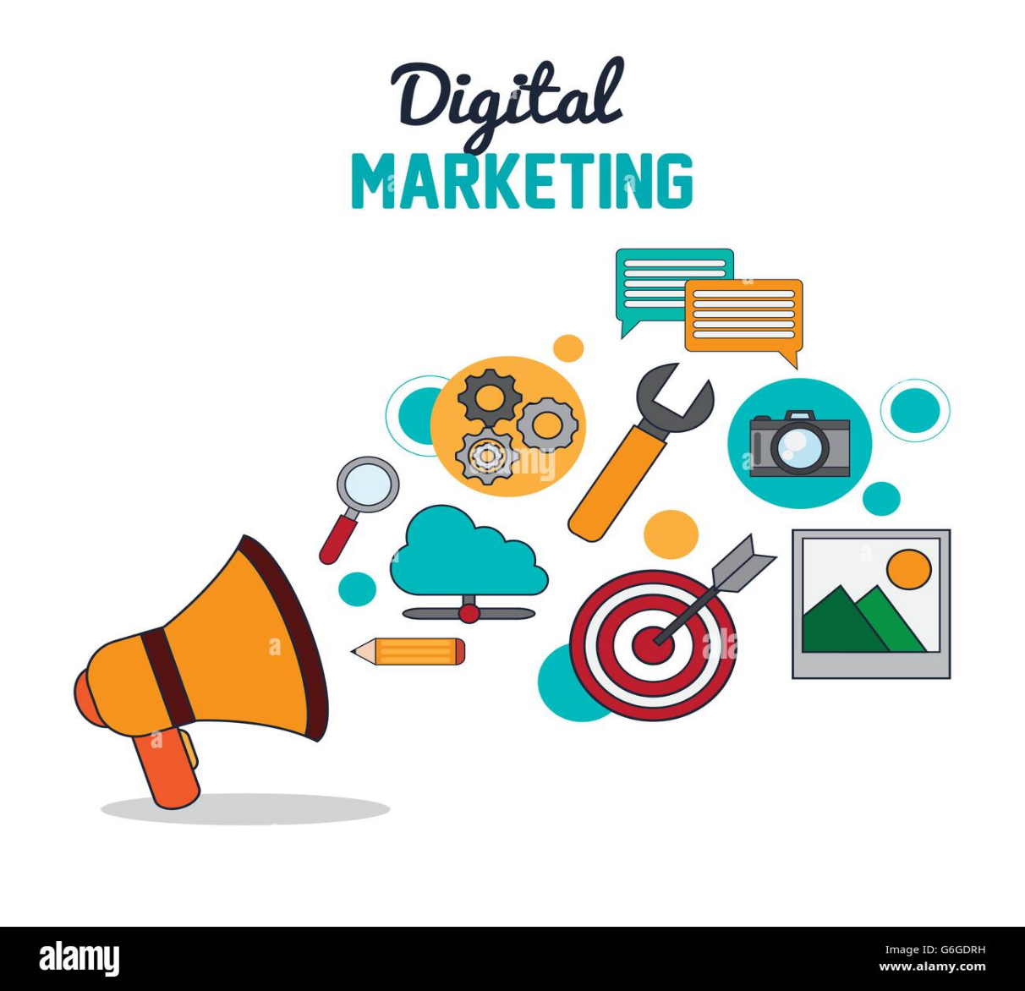
Digital Marketing and E-commerce
SEO (Search Engine Optimization)
Social media marketing
Paid advertising
Email marketing
Influencer marketing

Slide 11
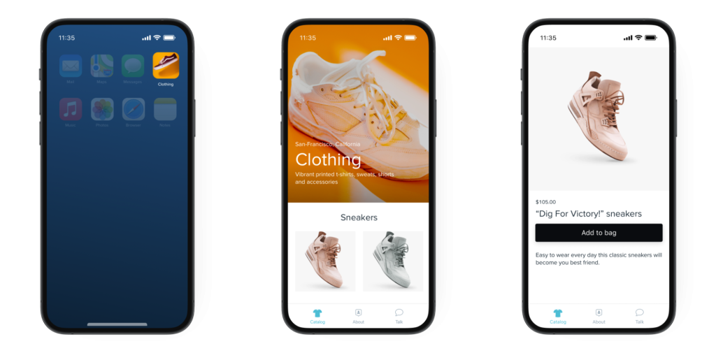
E-commerce and Mobile Apps
Mobile-friendly websites
Faster shopping through apps
Improved customer service
Instant notifications for updates
Easy mobile payments

Slide 12
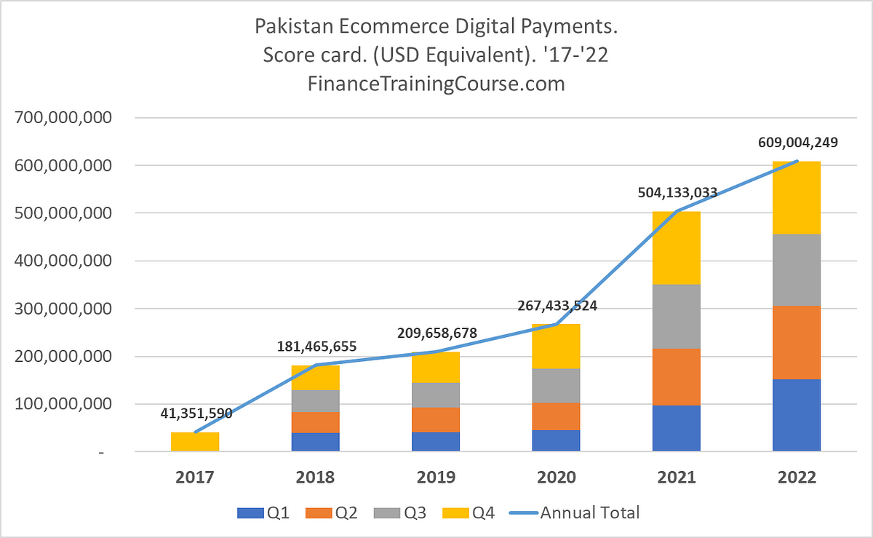
Growth of E-commerce in Pakistan
Rising trend of freelancing and online business
Payment gateways like EasyPaisa and JazzCash
Government support and new policies
Local market shifting towards online business
Increasing interest among youth in e-commerce

Slide 13

Future Opportunities in E-commerce
Automation and robotics
Virtual reality shopping
Blockchain and cryptocurrency Future Opportunities in E-commerce
payments
Data analytics for better business decisions

Slide 14
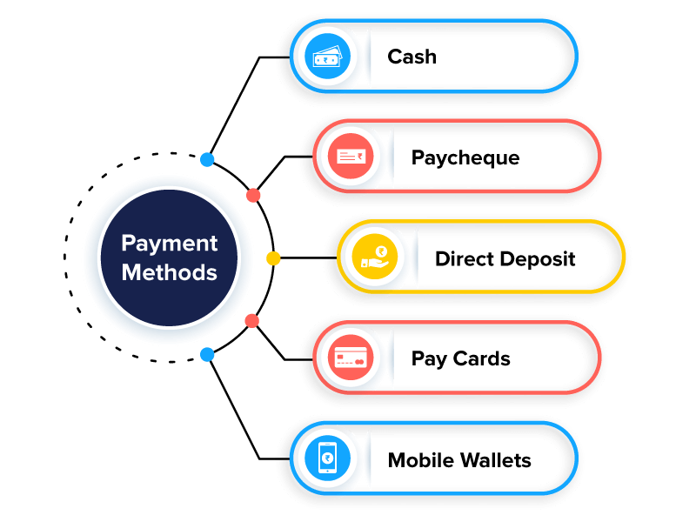
Payment Methods in E-commerce
Credit/Debit cards
Online banking
Digital wallets (PayPal, Google Pay)
Cash on delivery (COD)
Rising popularity of cryptocurrency payments

Slide 15
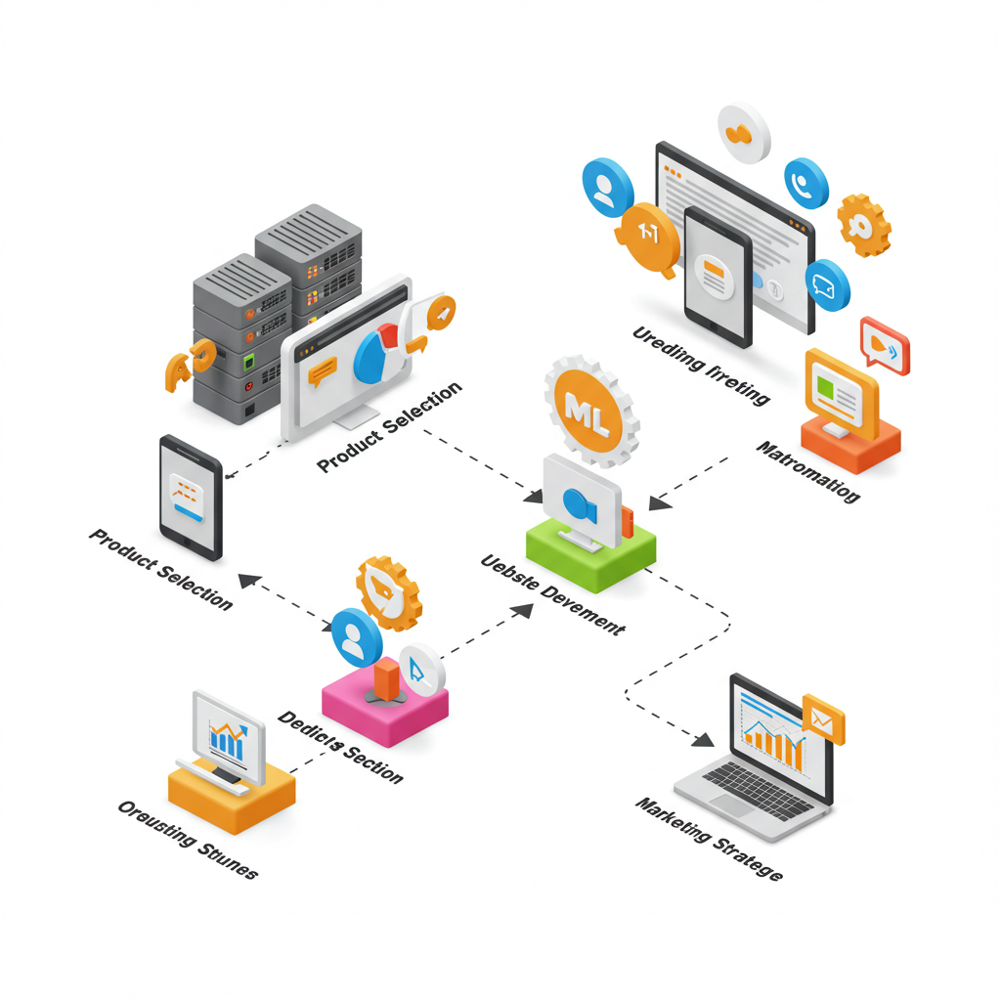
How to Start an E-commerce Business?
Product selection and research
Setting up a website or store
Marketing and customer support
Efficient logistics and delivery system
Branding and long-term growth planning

Slide 16

Secrets to Success in E-commerce
Branding and trustworthiness
Gaining customer confidence
Continuous improvement and updates
Keeping up with digital trends
Adapting business according to changing market needs

Slide 17

Conclusion
Bright future of e-commerce
Role of new technologies
A great business opportunity
Convenience for consumers
Endless growth possibilities for entrepreneurs

Slide 18


Slide 19


